Slide 1
Python Features
By Dr. Ahmed Awais

Slide 2
Quick Questions 27th April 2025
Set Comprehension to print squares from 0 to 9
Set comprehension to create a set of tuples (x, x^2) for x from 0 to 5
my_tuple = (1, 2, 3, 4, 5)
first_element = my_tuple[0] = ?
last_element = my_tuple[-1] = ?
# Concatenation
tuple1 = (1, 2)
tuple2 = (3, 4)
combined_tuple = tuple1 + tuple2 # Output: (?)
repeated_tuple = tuple1 * 3 # Output: (?)
repeated_list = [0] * 5
print(repeated_list) # Output: [] ?
my_list = [0, 1, 2, 3, 4, 5]
slice3 = my_list[1:5:2] # Output: []?

Slide 3
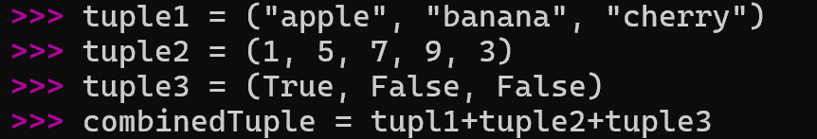
Quick Questions
my_tuple.count(3) # Output: ?
my_tuple.index(4) # Output: ?
nested_tuple = ((1, 2), (3, 4), (5, 6))
print(nested_tuple[1]) # Output: ?
my_tuple[0] = 10 # Output??

Slide 4
Solution
squares = {x**2 for x in range(10)}
tuples_set = {(x, x**2) for x in range(6)}

Slide 5
Object Identity and Equality (== vs is)
# Example of Object Identity
a = [1, 2, 3] # Creating a list
b = a # b references the same list object as a
print(a is b) # True, because both a and b point to the same object
print(id(a) == id(b)) # True, both have the same memory address
c = a[:] # c is a new list that is a copy of a
print(a is c) # False, c is a different object (different memory address)

Slide 6
Object Identity and Value Equality (== vs is)
# Example of Value Equality
x = [1, 2, 3] # Creating a list
y = [1, 2, 3] # Creating a different list with the same contents
print(x == y) # True, because the contents of x and y are equal
print(x is y) # False, because they are different objects in memory
z = x # z references the same object as x
print(x == z) # True, because they are the same object
print(x is z) # True, because they reference the same object

Slide 7
Object Identity and Equality (== vs is)
is checks if two variables point to the same object (identity).
== checks if two variables have the same value (equality).

Slide 8
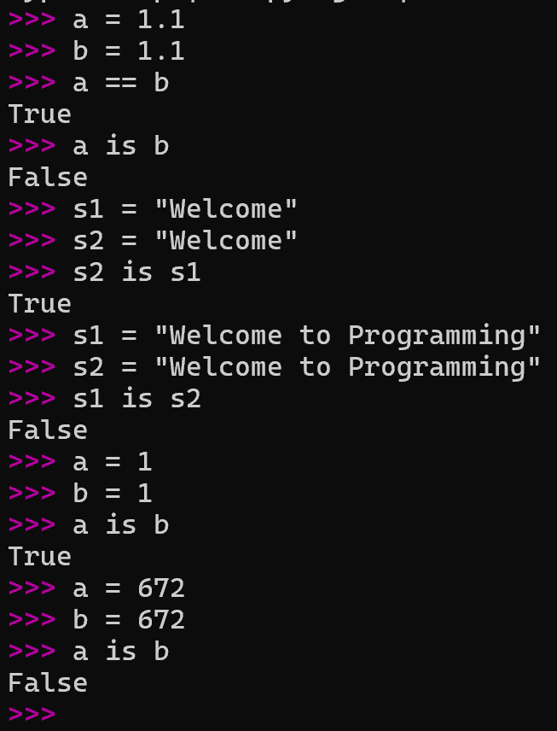

Slide 9
num1 = 5
num2 = 5
lst1 = [1, 2, 3]
lst2 = [1, 2, 3]
lst3 = lst1
str1 = "hello world"
str2 = "hello world"
# using 'is' identity operator on different datatypes
print(num1 is num2)
print(lst1 is lst2)
print(lst1 is lst3)
print(str1 is str2)

Slide 10
Some details about == vs is
String Interning: Python optimizes memory usage by "interning" certain strings. Interning means that when identical string literals are created, Python reuses the same memory location for those strings instead of creating new objects. This is particularly common for short strings and those that look like identifiers (e.g., variable names).
Non-Interned Longer Strings: For longer strings or strings that are not as common, Python might not intern them. When you do s1 = "awais ahmed" and s2 = "awais ahmed", Python may create two separate string objects in memory, even though their content is identical. This results in s1 is s2 returning False.

Slide 11
Print as statement vs function vs Pprint
In Python 2 -> print "Hello, world!“ # It was just and statement not the function
In Python 3, print is a function, which requires parentheses. This change was made to improve consistency and flexibility. For example:
# Python 3 print("Hello, world!")
Pprint stands for pretty-print

Slide 12
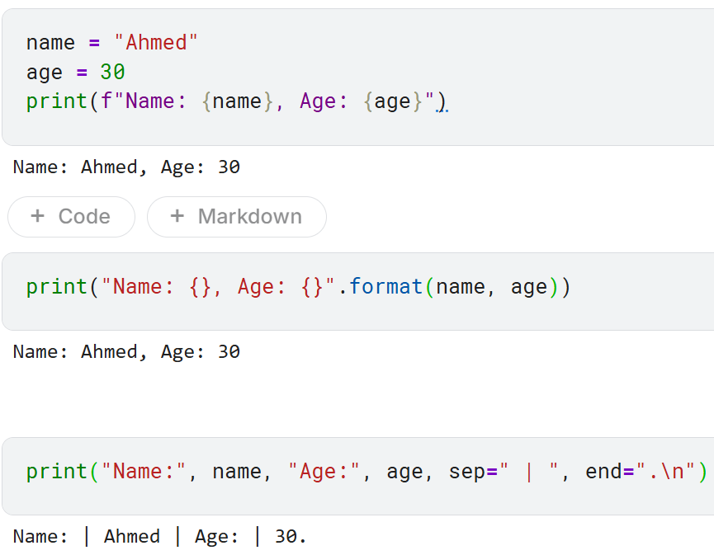

Slide 13
Print as statement vs function vs Pprint
The pprint function, provided by the pprint module, stands for "pretty-print".
It is used to print data structures like dictionaries and lists in a more readable format, especially useful for nested structures.

Slide 14
Print as statement vs function vs Pprint
Try this
data = {'name': ‘Ahmed', 'age': 30, 'city’: Nanchong'}
print(data)
Now Try this
from pprint import pprint
data = {'name': ‘Ahmed', 'age': 30, 'city’: ‘Nanchong', 'hobbies': ['reading’, ‘writing', 'coding’,’thinking’]}
pprint(data)

Slide 15
Print as statement vs function vs Pprint
You can customize pprint by creating an instance of PrettyPrinter and adjusting its parameters:
indent: Specifies the number of spaces to indent.
width: Specifies the maximum width of the output.
depth: Specifies the maximum depth to print nested structures.
compact: If set to True, it will try to fit more data into each line.
Now Try this
pp = PrettyPrinter(indent=4, width=40, depth=2, compact=True)
pp.pprint(data)

Slide 16
Packing and unpacking (Lists or Tuples)
Packing and unpacking in Python is useful technique for grouping values
A = 1,2,3
A# Guess, what it should print??
type(A)
A1 = [A,A]
A# Guess, what it should print??
type(A1)

Slide 17
Packing and unpacking (Lists or Tuples)
Packing and unpacking in Python is useful technique for grouping values
# Packing individual values into a list
a = 1
b = 2
c = 3
packed_list = [a, b, c]
print(packed_list) # Output: [?,?,?]
# Unpacking values from a list
packed_list = [1, 2, 3]
a, b, c = packed_list
print(a) # Output: ?
print(b) # Output: ?
print(c) # Output: ?

Slide 18
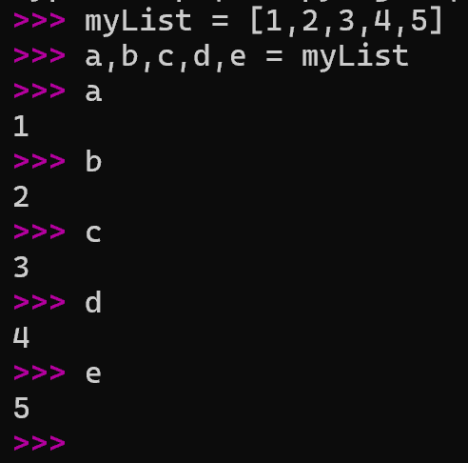
# Unpacking a tuple
a, b, c = (1, 2, 3)
print(a) # Output: 1
print(b) # Output: 2
print(c) # Output: 3

Slide 19
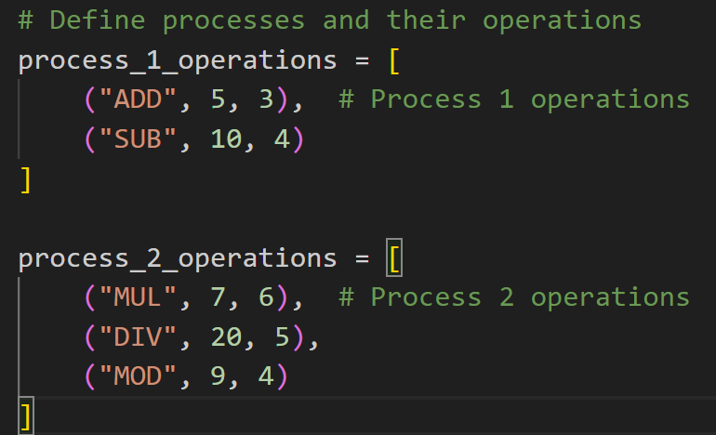

Slide 20
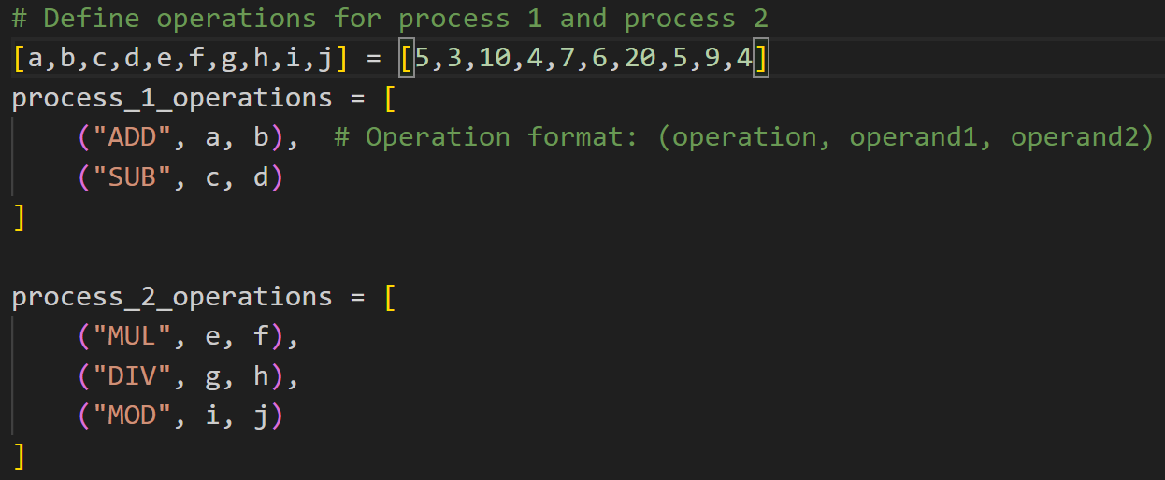

Slide 21
Using * for Unpacking
We can use the * operator to unpack lists when we don't know the exact number of elements or want to capture remaining elements.
# Unpacking with the * operator
packed_list = [1, 2, 3, 4, 5]
a, *b, c = packed_list
print(a) # Output: ?
print(b) # Output: [?, ?, ?]
print(c) # Output: ?
Here a is head, b is middle and c is the tail

Slide 22
Packing arguments in function definition
def mySum(*args):
return sum(args)
print(mySum(1, 2, 3, 4)) # Output: 10
# Unpacking arguments in function call
def myMul(a, b, c):
return a * b * c
numbers = (2, 3, 4)
print(myMul(*numbers)) # Output: 24

Slide 23
Packing arguments in function definition
import math
def myMul(*args):
return math.prod(args)
x = myMul(1, 2, 3)
print(x)

Slide 24
Function args or loop iterator packing and unpacking
# Example of unpacking
def unpack_example(packed):
a, b, c, d, e = packed
return a, b, c, d, e
packed = (1, 2, 3, 4, 5)
a, b, c, d, e = unpack_example(packed)
print(a, b, c, d, e) # Output: 1 2 3 4 5
# Example of packing
def example(*args):
return args
packed = example(1, 2, 3, 4, 5)
print(packed)

Slide 25
Function args or loop iterator packing and unpacking
pairs = [(1, 'one'), (2, 'two'), (3, 'three')]
for number, word in pairs:
print(f"Number: {number}, Word: {word}")
StudentData = [("Awais Ahmed","30","PhD"),("Ali",22,"BS in Progress")]

Slide 26
Function args or loop iterator packing and unpacking
# Packing values in a loop
data = []
for i in range(5):
data.append((i, i**2, i**3))
print(data) # Output: ?
# Unpacking values in a loop
data = [(0, 0, 0), (1, 1, 1), (2, 4, 8), (3, 9, 27), (4, 16, 64)]
for x, y, z in data:
print(f"x: {x}, y: {y}, z: {z}")
# Output:??

Slide 27
The tuple(), list(), str() as Function/Constructor
Tuple() or List() or Str() can be utilized as function(), which accepts (args*)
pi = 3.14159
string_pi = str(pi)
print(string_pi) # Output: '3.14159'
boolean_value = True
str_boolean = str(boolean_value)
str_boolean # ‘True’
print(str_boolean) # Output: True
number = 123
string_number = str(number)
print(string_number) # Output: '123'
my_list = [1, 2, 3]
string_list = str(my_list)
print(string_list) # Output: '[1, 2, 3]'

Slide 28
string_list = list("hello")
print(string_list) # Output: ['h', 'e', 'l', 'l', 'o']
tuple_list = list((1, 2, 3))
print(tuple_list) # Output: [1, 2, 3]
another_list = list([4, 5, 6])
print(another_list) # Output: [4, 5, 6]
# From a list
my_tuple = tuple([1, 2, 3])
# From a string
my_tuple = tuple('abc')
# From another tuple
my_tuple = tuple((4, 5, 6))

Slide 29
Pass-by-value vs pass-by-reference vs pass-by-value-result
Pass by Value
In pass by value, a copy of the actual parameter's value is passed to the function. Changes made to the parameter inside the function do not affect the original value. However, Python does not use pass by value for its variables.
Pass by Reference
In pass by reference, a reference to the actual parameter is passed to the function. Changes made to the parameter inside the function affect the original value. In Python, mutable objects (like lists, dictionaries, and sets) are passed by reference.

Slide 30
Pass-by-value vs pass-by-reference vs pass-by-value-result
Pass by Reference
In pass by reference, a reference to the actual parameter is passed to the function. Changes made to the parameter inside the function affect the original value. In Python, mutable objects (like lists, dictionaries, and sets) are passed by reference.
def modify_list(lst):
lst.append(4)
my_list = [1, 2, 3]
modify_list(my_list)
print(my_list) # ?
def modify_list(lst):
lst.append(4)
my_list = [1, 2, 3]
modify_list(my_list)
print(modify_list(my_list)) # ?
def modify_list(lst):
lst.append(4)
return lst
my_list = [1, 2, 3]
modify_list(my_list)
print(modify_list(my_list)) # ?

Slide 31
Pass-by-value vs pass-by-reference vs pass-by-value-result
Pass by value-result is a hybrid approach where a copy of the actual parameter's value is passed to the function, and then the result is copied back to the original variable after the function execution.
Python does not directly support pass by value-result, but we can mimic this behavior using a combination of copying and assignment.
def modify_value(val):
val = val + 1
return val
my_val = 10
my_val = modify_value(my_val)
print(my_val) # Output: 11

Slide 32
Pass-by-value vs pass-by-reference vs pass-by-value-result
Pass by Value: Not directly used in Python.
Pass by Reference: Used for mutable objects.
Pass by Value-Result: Can be mimicked using copying and assignment.

Slide 33
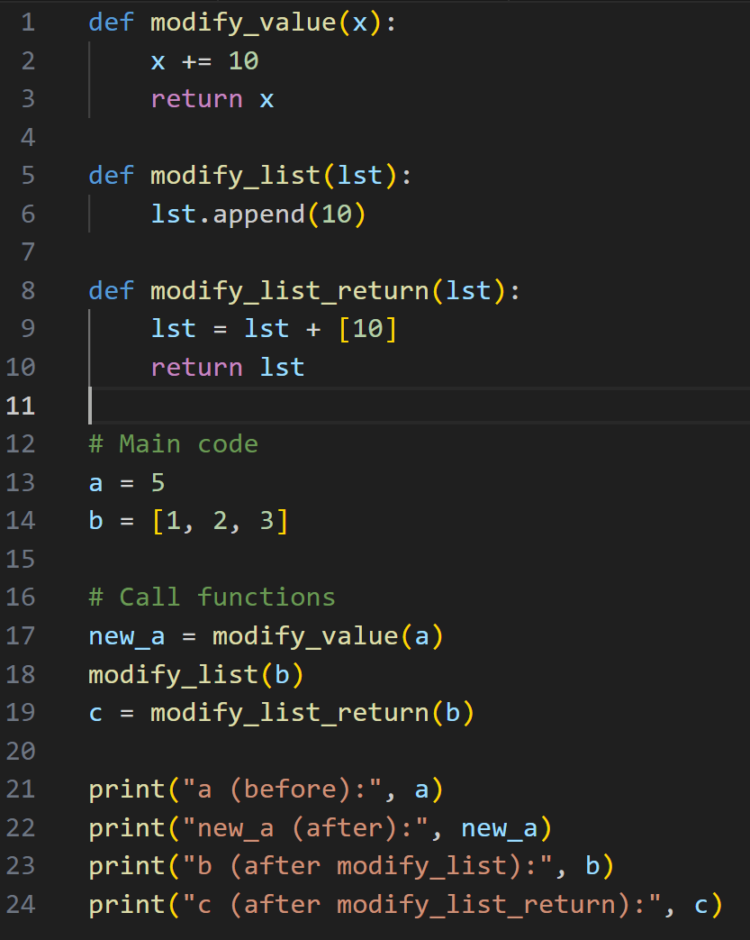

Slide 34
a (before): 5
new_a (after): 15
b (after modify_list): [1, 2, 3, 10]
c (after modify_list_return): [1, 2, 3, 10]

Slide 35
Zip Function
The zip function in Python

Slide 36
Serializing and de-serializing a Python object structure (Pickle)
The Pickle function in Python

Slide 37
Lambda Functions in Python
A lambda function in Python is a small, anonymous function defined using the lambda keyword. Unlike regular functions defined with def, lambda functions can have any number of arguments but only one expression. The expression is evaluated and returned.
The basic syntax of a lambda function is:
lambda arguments: expression
x = lambda a: a + 10
print(x(5))
def add_ten(a):
return a + 10
print(add_ten(5)) # Output: 15

Slide 38
Lambda Functions in Python
def multiply(a, b):
return a * b
print(multiply(5, 6)) # Output: 30
x = lambda a, b: a * b
print(x(5, 6))

Slide 39
Lambda Functions in Python
def myfunc(n):
return lambda a: a * n

Slide 40
Json vs Dictionary
Before moving further for comparsion – let’s understand what is Json?

Slide 41
Json | Dictionary
JSON keys can only be strings. | The dictionary's keys can be any hashable object.
The keys in JSON are ordered sequentially and can be repeated. | The keys in the dictionary cannot be repeated and must be distinct.
The keys in JSON have a default value of undefined. | There is no default value in dictionaries.
The values in a JSON file are accessed by using the "." (dot) or "[]" operator. | The subscript operator is used to access the values in the dictionary. For example, if 'dict' = 'A':'123R','B':'678S', we can retrieve data related by simply calling dict['A'].
For the string object, we must use double quotation marks. | For string objects, we can use either a single or double quotation.
In JSON, the return object type is a'string' object type. | The 'dict' object type is the return object type in a dictionary.

Slide 42
Reading assignment
Learn about usage of map(), filter(), and sorted() with Lambda

Slide 43
Reading assignment
Python __repr__()
Python __str__()
Python __init__()
Python __hash__(), Python __eq__(), Python __cmp__(),

Slide 44
What does "hashable“ object mean in Python?

Slide 45
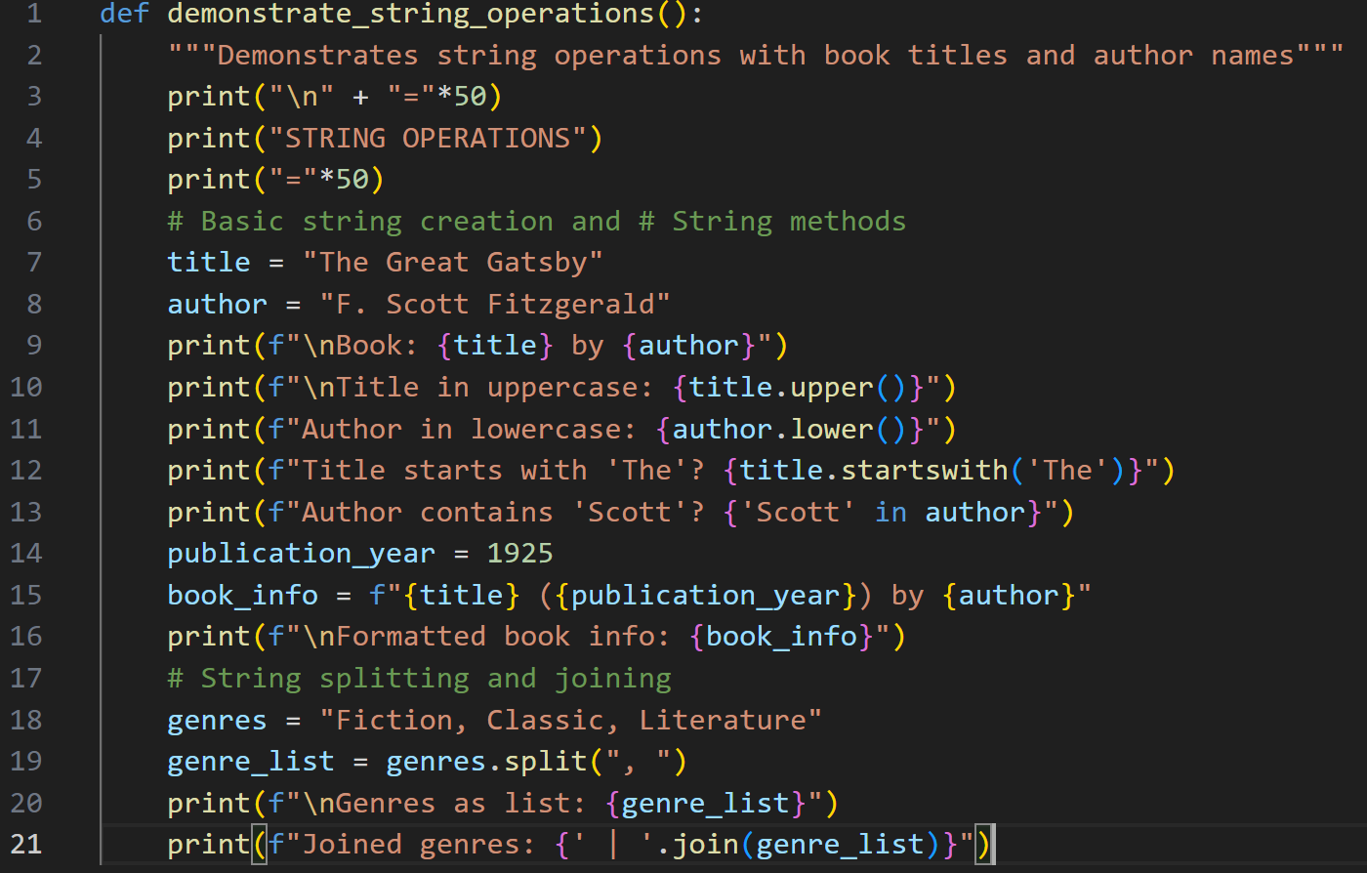

Slide 46
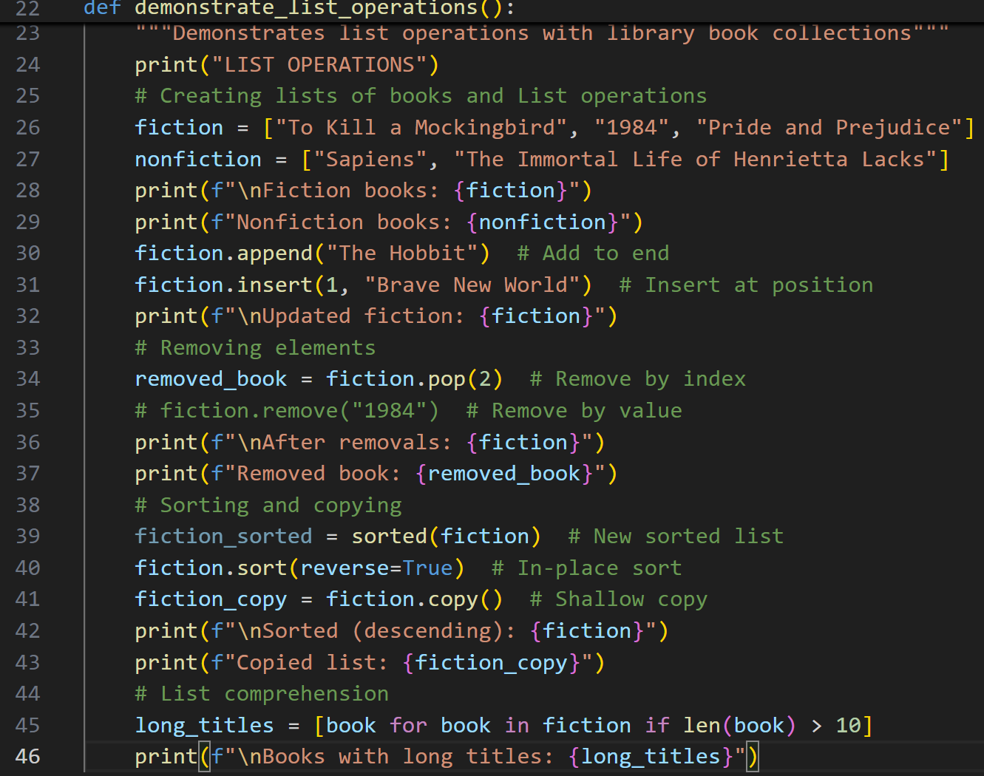

Slide 47
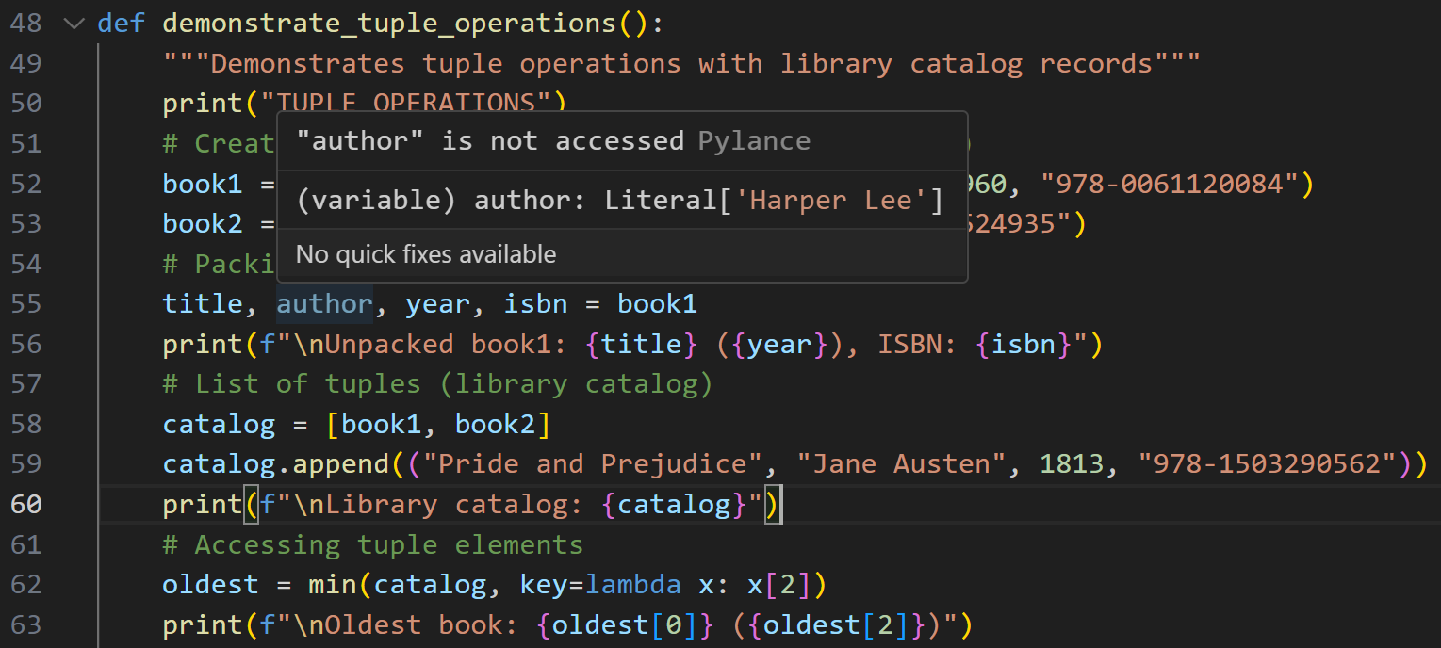

Slide 48
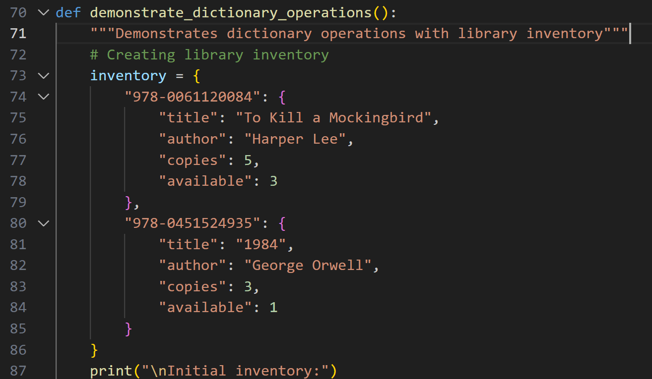

Slide 49
